Slide 1
Visual Classification
Last updated: 14-04-2024
[NCV] Computer Vision, The National Programme on Technology Enhanced Learning (NPTEL), https://nptel.ac.in/courses/106/105/106105216/
Dr. Zulfiqar Habib, Professor
http://vig.cuilahore.edu.pk

Slide 2
Teacher Appreciation
“A student's progress should be measured in terms of the questions they are asking, not merely by the answers that they are reciting”
- Robert John Meehan -

Slide 3
Common Approach
Model Generation
Models
Training
Testing
Image acquisition
Preprocessing
Segmentation
Feature extraction
Recognition
Classification Regression
Clustering
Problem domain
Knowledge base
Result

Slide 4
Popular Classifiers
K-Nearest Neighbor (KNN)
SVM
SVMLight
LIBSVM (Library for Support Vector Machines)
Neural Netwroks
Deep Learning
Transfer Learning
Extreme Learning Machines (ELM)
Reinforcement learning

Slide 5
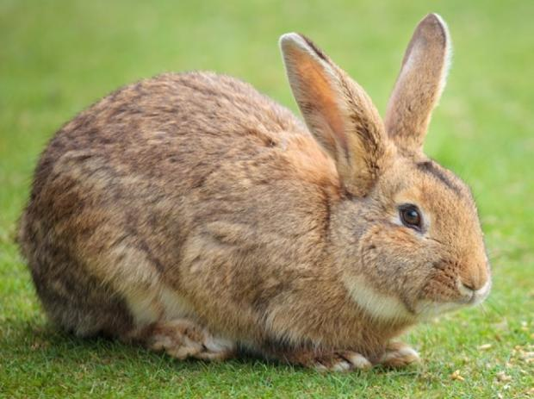
Image Classification
A core task in computer vision
Given a set of discrete labels: {rabbit, cat, glass, plane, ...}
Rabbit
Notes:
Handouts: http://cs231n.github.io/classification/#intro

Slide 6
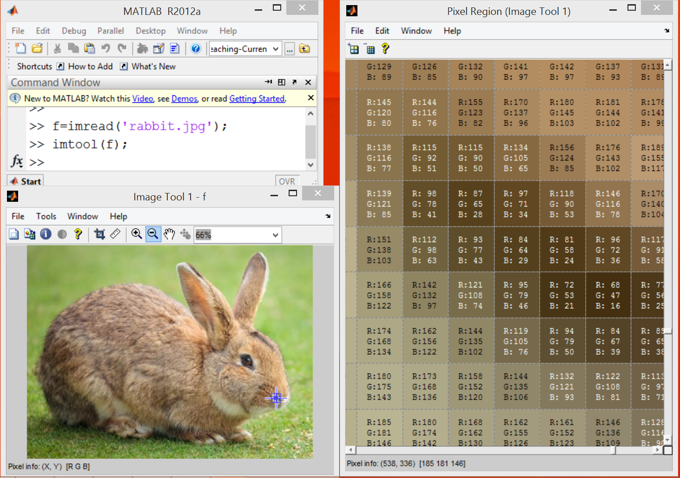
Image Classification: The Problem
Human vs Machine Perception: Images are represented as R^{d} arrays of numbers, e.g., R³ with integers between [0, 255], where d = 3 represents 3 color channels (RGB)
What the machine (computer) sees

Slide 7
Image Classification: Challenges
Viewpoint variation
Illumination
Michelangelo 1475-1564

Slide 8
Image Classification: Challenges
Scale

Slide 9
Image Classification: Challenges
Deformation
Occlusion

Slide 10
Image Classification: Challenges
Background clutter
Intra-class variation
Kilmeny Niland 1995

Slide 11
An Image Classifier
>> f = imread('rabbit.jpg');
>> predict(f)
????
Unlike, e.g., sorting a list of numbers,
no obvious way to hard-code the algorithm for recognizing a cat, or other classes.

Slide 12
An Image Classifier: Data-driven approach
Use Machine Learning to train an image classifier on some part of annotated data
Evaluate the classifier on a withheld set of test images

Slide 13
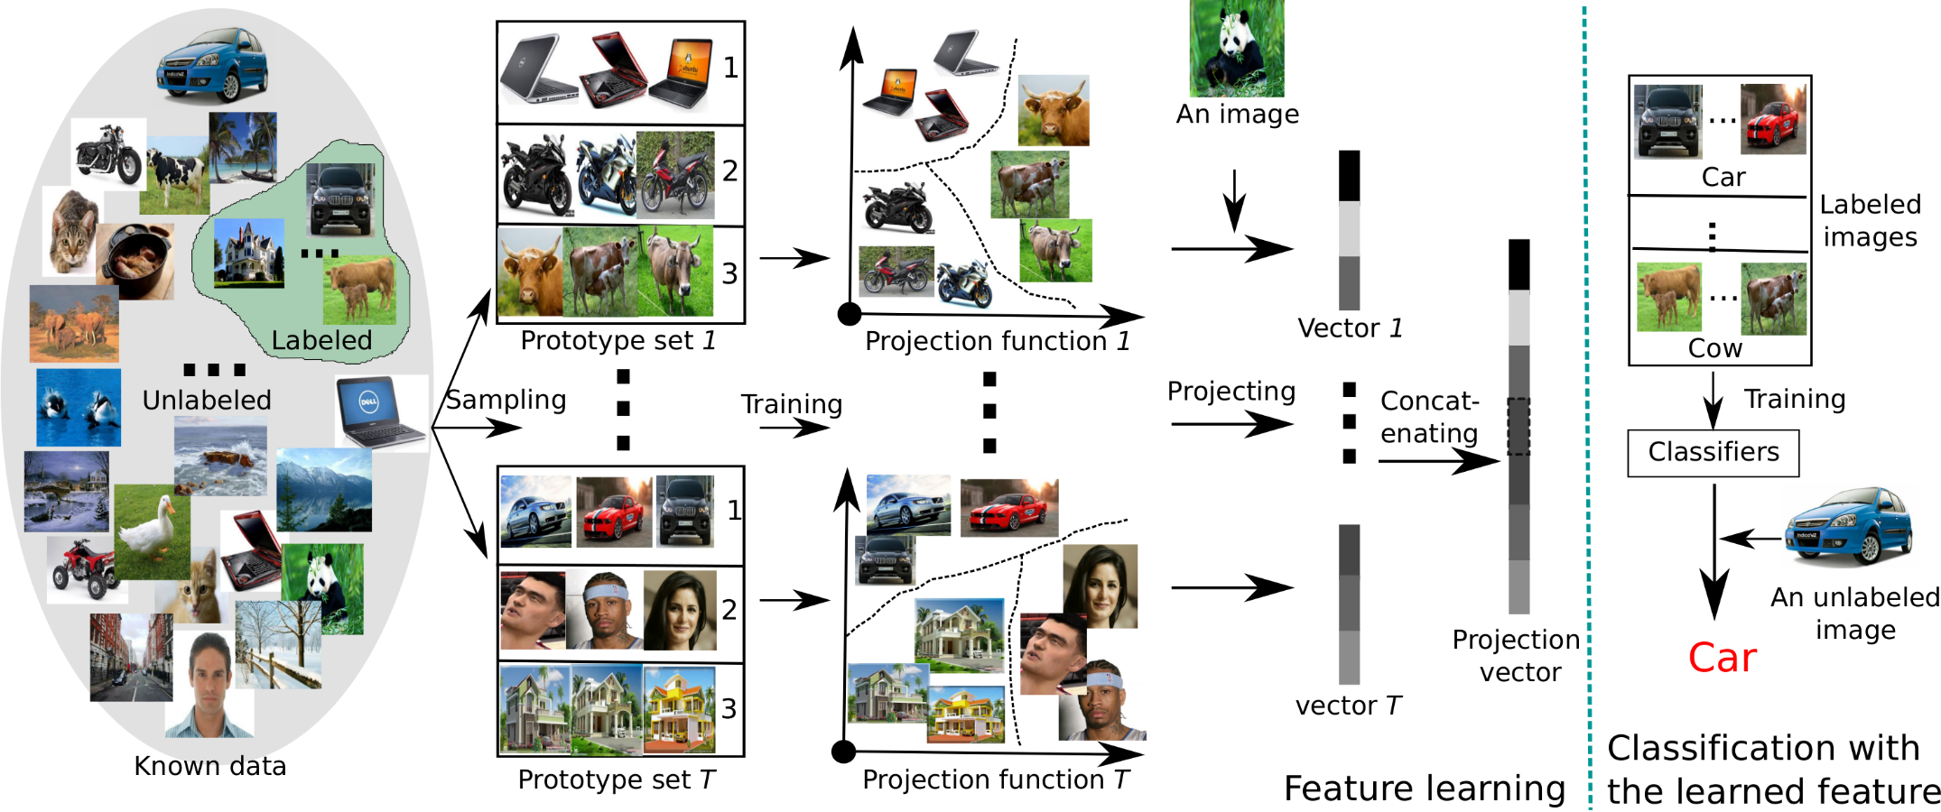
The Image Classification Pipeline
(Input)
Dataset collection & labelling
(Learning)
Learning & training an image classifier
(Evaluation)
Testing of classifier on withheld images
Notes:
http://people.ee.ethz.ch/~daid/EnPro/

Slide 14
The Image Classification Pipeline
Input: Our input consists of a set of N images, each labelled with one of K different classes. We refer to this data as the training set.
Learning: Our task is to use the training set to learn what every one of the classes looks like. We refer to this step as training a classifier, or learning a model.
Evaluation: Evaluate the quality of the classifier by asking it to predict labels for a new set of images that it has never seen before. We will then compare the true labels of these images to the ones predicted by the classifier. Intuitively, we're hoping that a lot of the predictions match up with the true answers (which we call the ground truth).

Slide 15
The Machine Learning Framework
y = f(x)
Output Prediction function Image feature
Training: given a training set of labelled examples {(x₁,y₁), …, (x_{N},y_{N})}, estimate the prediction function f by minimizing the prediction error on the training set
Testing: apply f to a never before seen test example x and output the predicted value y = f(x)
For further detail watch
Lecture 46, 47

Slide 16
Nearest Neighbor Classifier
Assign label of nearest training data point to each test data point

Slide 17
Nearest Neighbor Classifier
Assign label of nearest training data point to each test data point
Partitioning of feature space for two-category 2D and 3D data

Slide 18
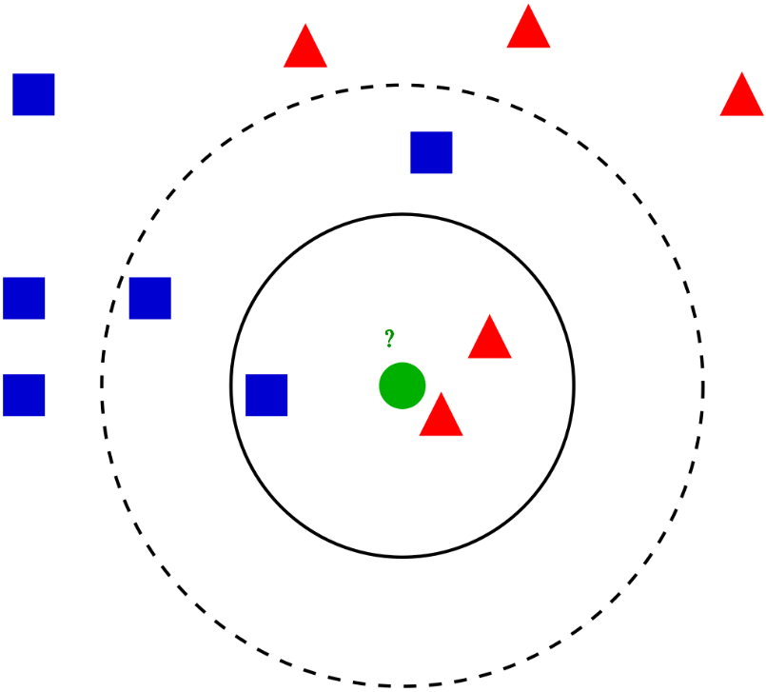
K Nearest Neighbor (KNN)
Distance measure: Euclidean
where X^{n} and X^{m} are the n-th and m-th data points
The test sample (green dot) should be classified either to blue squares or to red triangles. If k = 3 (solid line circle) it is assigned to the red triangles because there are 2 triangles and only 1 square inside the inner circle. If k = 5 (dashed line circle) it is assigned to the blue squares (3 squares vs. 2 triangles inside the outer circle).

Slide 19
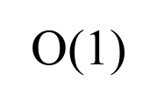
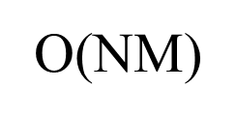
KNN vs K-Means Clustering
KNN represents a supervised classification algorithm that will give new data points accordingly to the k number or the closest data points, while K-Means clustering is an unsupervised clustering algorithm that gathers and groups data into k number of clusters.
Q: What is the complexity of the 1-NN classifier w.r.t. training set of N images and test set of M images?
at training time?
at test time?

Slide 20
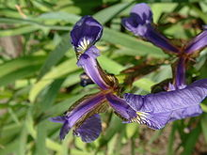
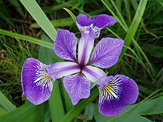
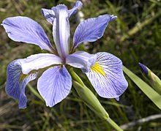
Example: Sample of data set
Given: Fisher's Iris dataset: DataIris (data size = 150)
Species of Iris: petal sepal
Setosa Versicolor Virginica
The data set consists of 50 samples from each of three species of Iris.
Four features were measured from each sample: the length and the width of the sepals and petals, in centimeters.
Notes:
KNN.mlx
ClassifyingQueryDataUsingKnnsearchExample.mlx
http://en.wikipedia.org/wiki/Iris_flower_data_set
http://www.bliasoft.com/data-mining-software-iris.html

Slide 21
Example: Sample of data set
No. | Sepal. length | Sepal. width | Petal. length | Petal. width | Species
1 | 5.1 | 3.5 | 1.4 | 0.2 | setosa
2 | 4.9 | 3.0 | 1.4 | 0.2 | setosa
3 | 4.7 | 3.2 | 1.3 | 0.2 | setosa
4 | 4.6 | 3.1 | 1.5 | 0.2 | setosa
…
76 | 6.6 | 3.0 | 4.4 | 1.4 | versicolor
…
150 | 5.9 | 3.0 | 5.1 | 1.8 | virginica

Slide 22
Example
Task: To classify a sample of 150 irises in the 3 following species: versicolor, virginica and setosa
Number of given attributes: 4
From 4 characteristics measured on the flowers (the length of the sepal, the width of the sepal, the length of the petal and the width of the petal). In this example, only last 2 attributes are considered.
Type of attribute to be predicted:
Discrete with 3 classes

Slide 23
Example: Code…
% Load the sample data, which includes Fisher's iris data of 5 measurements on a sample of 150 irises.
>> load fisheriris
>> whos
Name Size Bytes Class Attributes
meas 150x4 4800 double
species 150x1 19300 cell
>> species
species =
'setosa'
'setosa'
-------
'versicolor'
'versicolor'
-------
'virginica'
'virginica'
-------
>> meas
meas =
5.1000 3.5000 1.4000 0.2000
4.9000 3.0000 1.4000 0.2000
4.7000 3.2000 1.3000 0.2000
4.6000 3.1000 1.5000 0.2000
5.0000 3.6000 1.4000 0.2000
-------- ------- ------- --------

Slide 24
Example: Code…
>> x = meas(:, 3:4); % use data of last 2 columns for fitting
>> y = species; % response data
>> mdl = ClassificationKNN.fit(x, y) % 1NN
mdl =
ClassificationKNN:
PredictorNames: {'x1' 'x2'}
ResponseName: 'Y'
ClassNames: {1x3 cell}
ScoreTransform: 'none'
NObservations: 150
Distance: 'euclidean'
NumNeighbors: 1

Slide 25
Example: Code…
% Predict the classification of an average flower
>> flwr = mean(x) % an average flower
flwr =
3.7580 1.1993
>> flwrClass = predict(mdl, flwr)
flwrClass =
'versicolor‘
Petal width
>> gscatter(x(:, 1), x(:, 2), species)
>> set(legend, 'location', 'best')
>> line(flwr(1), flwr(2), 'marker', 'x', 'color', 'k', 'markersize', 10, 'linewidth', 2)
Petal length

Slide 26
Example: Code
% Predict another flower
>> flwr = [5 1.55]; % Given (petal length, petal width)
>> flwrClass = predict(mdl, flwr) % prediction by 1NN
flwrClass =
'virginica‘
>> md5 = ClassificationKNN.fit(x,y,'NumNeighbors',5); % 5NN
>> flwrClass = predict(md5, flwr) % prediction by 5NN
flwrClass =
'versicolor'
Why different?

Slide 27
Example: Analysis
Species Length Width Distance
virginica 5.0000 1.5000 0.0500
versicolor 4.9000 1.5000 0.1118
versicolor 4.9000 1.5000 0.1118
versicolor 5.1000 1.6000 0.1118
virginica 5.1000 1.5000 0.1118
Value Count Percent
virginica 2 40.00%
versicolor 3 60.00%

Slide 28
K Nearest Neighbor (KNN)
Find the k nearest images, have them vote on the label
What is the best distance to use?
What is the best value of k to use?
i.e. how do we set the hyperparameters?
Very problem-dependent.
Must try them all out and see what works best.
For further detail watch
Lecture 48

Slide 29
SVM
Support Vector Machine (SVM) is a supervised learning algorithm developed by Vladimir Vapnik and it was first heard in 1992, introduced by Vapnik, Boser and Guyon in COLT-92.
SVM can be used for both classification or regression challenges. However, it is mostly used in classification problems.
SVM works by mapping data to a high-dimensional feature space so that data points can be categorized, even when the data are not otherwise linearly separable. A separator between the categories is found, then the data are transformed in such a way that the separator could be drawn as a hyperplane.
Notes:
Vikramaditya Jakkula : “Tutorial on Support vector machines” school of EECS Washington State University .

Slide 30
SVM
For detail
SVM.pptx
Notes:
Vikramaditya Jakkula : “Tutorial on Support vector machines” school of EECS Washington State University .

Slide 31
Example: Visual Classification by SVM
Given: Caltech 101 dataset [1].
We consider its 2 folders only: “aeroplane” and “faces”
Make two folders: TrainSet & TestSet. Copy pictures
01-50 from “aeroplane” to TrainSet
51-100 from “faces” to TrainSet
01-50 from “faces” to TestSet
51-100 from “aeroplane” to TestSet
Download from
https://data.caltech.edu/records/20086
[1] L. Fei-Fei, R. Fergus and P. Perona. Learning generative visual models from few training examples: an incremental Bayesian approach tested on 101 object categories. IEEE. CVPR 2004, Workshop on Generative-Model Based Vision. 2004
Notes:
https://www.vision.caltech.edu/datasets/

Slide 32
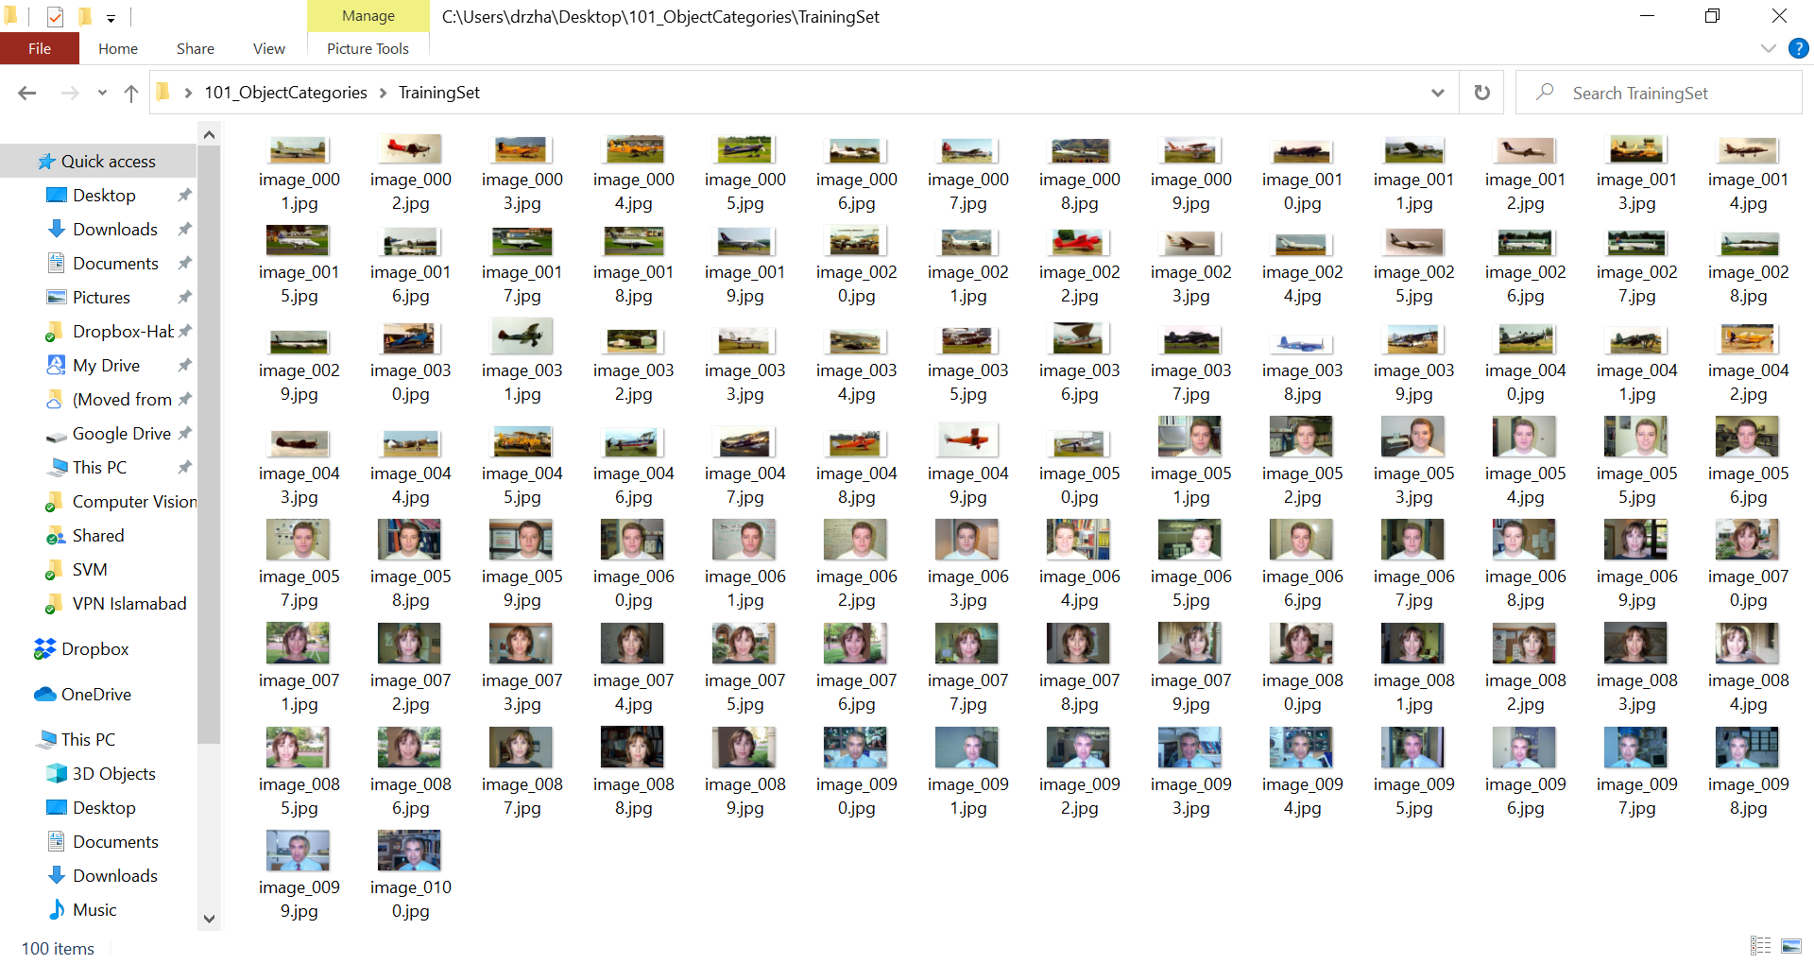
Example: Visual Classification by SVM
TrainingSet
Notes:
http://www.vision.caltech.edu/Image_Datasets/Caltech101/

Slide 33
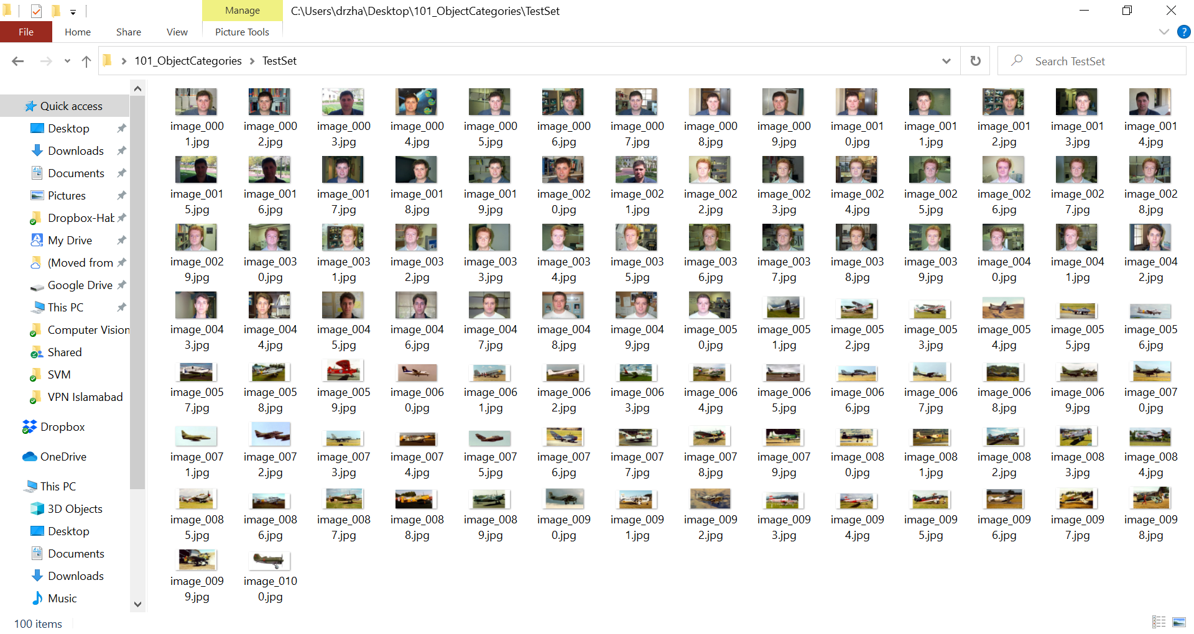
Example: Visual Classification by SVM
TestSet
Notes:
http://www.vision.caltech.edu/Image_Datasets/Caltech101/

Slide 34
SVM: Code…
clc; clear; clearvars; close all;
% Load datasets
TrainImageSet = 'D:\Classification\Data\101_ObjectCategories\TrainingSet';
TestImageSet = 'D:\Classification\Data\101_ObjectCategories\TestSet';
% struct array with fields: name, date, bytes, isdir, datenum
k = dir(fullfile(TrainImageSet,'*.jpg'));
TrainFN = {k(~[k.isdir]).name}; % store file names of all images, not directories
TrainSetSize = length(TrainFN);
k = dir(fullfile(TestImageSet,'*.jpg'));
TestFN = {k(~[k.isdir]).name};
TestSetSize = length(TestFN);

Slide 35
SVM: Code…
% Labelling, it is always better to label your images numerically
TrainLabel = zeros(size(TestSetSize,1),1);
TrainLabel(1:50,1) = 1; % 1 = Airplanes
TrainLabel(51:100,1) = 2; % 2 = Faces
TestLabel = zeros(size(TestSetSize,1),1);
TestLabel(1:50,1) = 2; % 2 = Faces
TestLabel(51:100,1) = 1; % 1 = Airplanes

Slide 36
SVM: Code…
% Normalization: Conversion into grayscale if not already & resizing into same size
width = 8; height = 8; % Normalized image size
% Normalization of training images
TrainSet = cell([], 1);
for j=1:TrainSetSize
tempImage = imread(horzcat(TrainImageSet,filesep,TrainFN{j}));
imgInfo = imfinfo(horzcat(TrainImageSet,filesep,TrainFN{j}));
if strcmp(imgInfo.ColorType,'grayscale')
TrainSet{j} = imresize(tempImage,[width height]);
else
TrainSet{j} = imresize(rgb2gray(tempImage),[width height]);
end
end
j=1;
>> imshow(tempImage)
>> strcmp(imgInfo.ColorType,'grayscale')
ans =
logical
0
>> imshow(TrainSet{j})

Slide 37
SVM: Code…
% Normalization of test images
TestSet = cell([], 1);
for j=1:TestSetSize
tempImage = imread(horzcat(TestImageSet,filesep,TestFN{j}));
imgInfo = imfinfo(horzcat(TestImageSet,filesep,TestFN{j}));
if strcmp(imgInfo.ColorType,'grayscale')
TestSet{j} = imresize(tempImage,[width height]);
else
TestSet{j} = imresize(rgb2gray(tempImage),[width height]);
end
end

Slide 38
SVM: Code…
% Numeric matrix of features, every row is a feature vector for 1 image
Training_Set = uint8(zeros(TrainSetSize,width*height)); % code optimization by preallocating the memory
for j=1:length(TrainSet)
Training_Set(j,:) = reshape(TrainSet{j},1, width*height);
end
Test_Set = uint8(zeros(TestSetSize,width*height));
for j=1:length(TestSet)
Test_Set(j,:) = reshape(TestSet{j},1, width*height);
end
>> j=1;
>> Training_Set_tmp = reshape(TrainSet{j},1, width*height)
Training_Set_tmp = 1×64 uint8 row vector
Columns 1 through 19
247 249 252 230 202 219 215 228 233 210 184 166 87 122 125 173 225 223 205
Columns 20 through 38
156 149 109 129 171 219 218 223 179 143 62 100 169 218 217 217 189 152 92
Columns 39 through 57
106 167 215 216 217 189 144 86 113 163 209 202 181 122 84 116 109 153 232
Columns 58 through 64
218 179 158 167 198 185 201

Slide 39
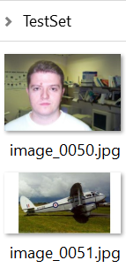
SVM: Code
% SVM training
SVMModel = fitcsvm(double(Training_Set), TrainLabel);
Classes = predict(SVMModel, double(Test_Set));
% SVM testing
MissClassified = find(TestLabel-Classes).'
Accuracy = (TestSetSize-length(MissClassified))/TestSetSize*100
MissClassified = 1×7
1 3 14 15 16 21 45
Accuracy = 93
>> predict(SVMModel, double(Test_Set(50,:)))
ans =
2
>> predict(SVMModel, double(Test_Set(51,:)))
ans =
1
Face
Accuracy is 90% for 5x5, 93% for 8x8, 10x10 or 100x100
Aeroplane

Slide 40
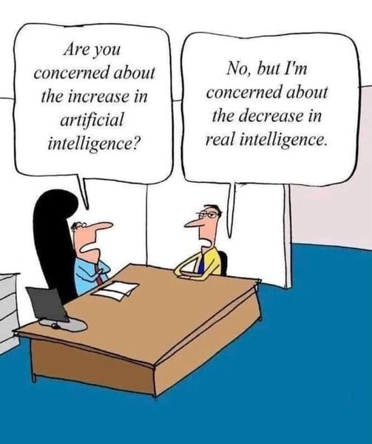

Slide 41
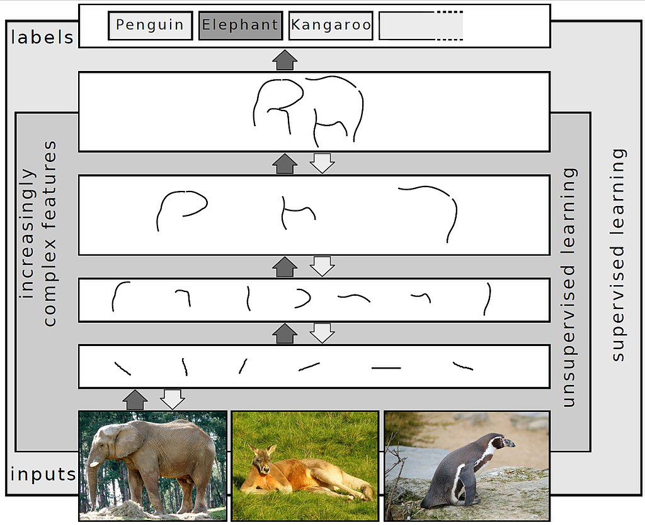
Neural Network => Deep Learning
Deep learning is a class of machine learning algorithms that uses multiple layers to progressively extract higher level features from the raw input.
For example, in image processing, lower layers may identify edges, while higher layers may identify the concepts relevant to a human such as digits or letters or faces.
Notes:
https://en.wikipedia.org/wiki/Deep_learning

Slide 42
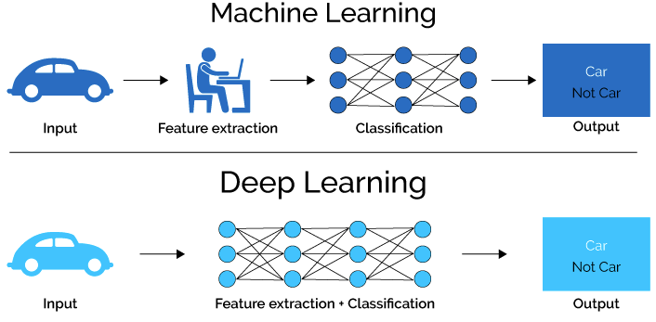
Neural Network => Deep Learning
Deep learning (also known as deep structured learning) is part of a broader family of machine learning methods based on artificial neural networks with representation learning. Learning can be supervised, semi-supervised or unsupervised.
Handcrafted Machine Learning
Input layer – Hidden layers – output layer
Notes:
https://en.wikipedia.org/wiki/Deep_learning

Slide 43
Neural Network => Deep Learning
Deep learning architectures such as deep neural networks, deep belief networks, recurrent neural networks and convolutional neural networks (CNN) have been applied to fields including:
Computer vision, speech recognition, natural language processing, audio recognition, social network filtering, machine translation, bioinformatics, drug design, medical image analysis, material inspection and board game programs.
Results are produced comparable to and in some cases surpassing human expert performance.
Notes:
https://en.wikipedia.org/wiki/Deep_learning

Slide 44
Neural Network => Deep Learning => Transfer Learning
Transfer learning is commonly used in deep learning applications. You can take a pretrained network and use it as a starting point to learn a new task.
Fine-tuning a network with transfer learning is usually much faster and easier than training a network with randomly initialized weights from scratch. You can quickly transfer learned features to a new task using a smaller number of training images. Popular pretrained CNN models are:
AlexNet
GoogLeNet
ResNet (18, 50, 101)
Notes:
Try Deep Learning in 10 Lines of MATLAB Code

Slide 45
Transfer Learning Using AlexNet
AlexNet is a pretrained convolutional neural network. It can be fine-tuned to perform classification on a new collection of images.
AlexNet has been trained on over a million images and can classify images into 1000 object categories (such as keyboard, coffee mug, pencil, and many animals).
The network has learned rich feature representations for a wide range of images. The network takes an image as input and outputs a label for the object in the image together with the probabilities for each of the object categories.

Slide 46
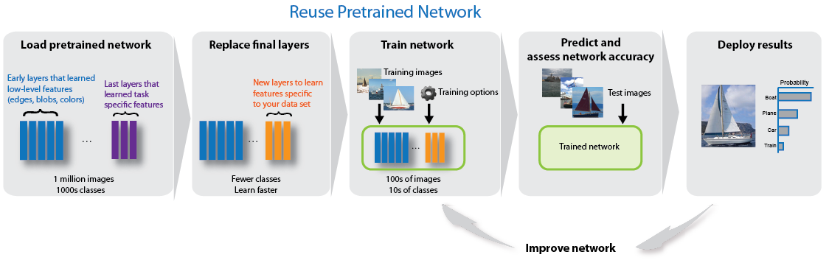
Transfer Learning Using AlexNet

Slide 47
Transfer Learning Using AlexNet

Slide 48
Transfer Learning Using AlexNet

Slide 49
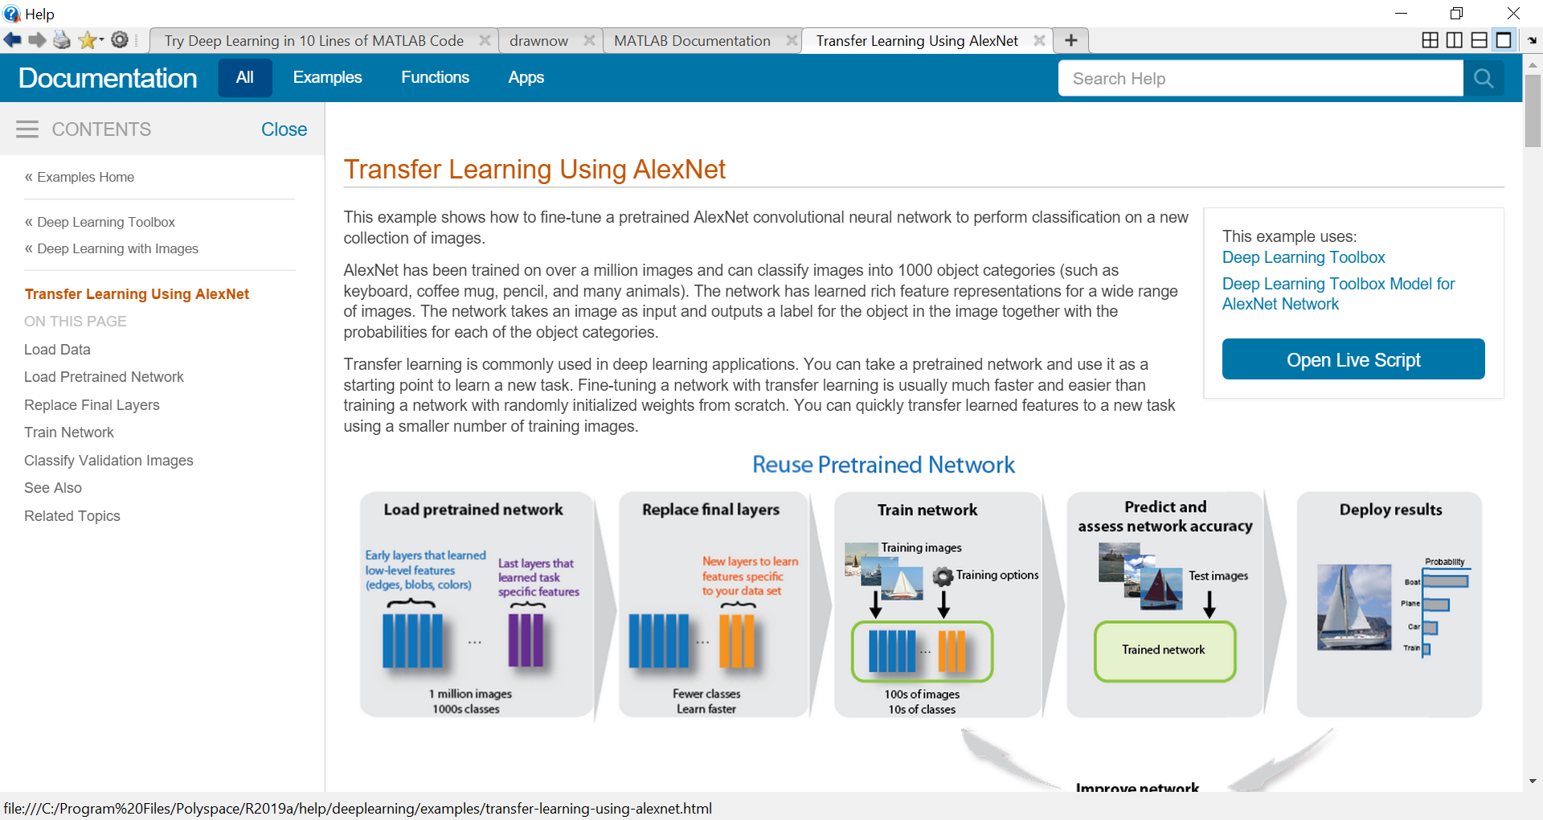
Transfer Learning Using AlexNet: Example…

Slide 50
Transfer Learning Using AlexNet: Example…
Load Data: Unzip and load the new images as an image datastore. imageDatastore automatically labels the images based on folder names and stores the data as an ImageDatastore object. An image datastore enables you to store large image data, including data that does not fit in memory, and efficiently read batches of images during training of a convolutional neural network.
>> numel(imds.Labels)
ans = 75
>> I = readimage(imds,5);
>> imshow(I)
>> I = readimage(imds,52);
>> imshow(I)
>> size(I)
ans = 227 227 3
unzip('MerchData.zip');
imds = imageDatastore('MerchData', ...
'IncludeSubfolders',true, ...
'LabelSource','foldernames');
This is very small data set contains only 75 images.
Notes:
TransferLearningUsingAlexNetExample.mlx

Slide 51
Transfer Learning Using AlexNet: Example…
Divide the data into training and validation data sets. Use 70% of the images for training and 30% for validation. splitEachLabel splits the images datastore into two new datastores.
[imdsTrain,imdsValidation] = splitEachLabel(imds,0.7,'randomized');
>> numTrainImages = numel(imdsTrain.Labels)
numTrainImages = 55

Slide 52
Transfer Learning Using AlexNet: Example…
Load the pretrained AlexNet neural network. If Neural Network Toolbox™ Model for AlexNet Network is not installed, then the software provides a download link. AlexNet is trained on more than one million images and can classify images into 1000 object categories, such as keyboard, mouse, pencil, and many animals. As a result, the model has learned rich feature representations for a wide range of images.
net = alexnet;

Slide 53
Transfer Learning Using AlexNet: Example…
>> net.Layers % or analyzeNetwork(net)
ans = 25x1 Layer array with layers:
1 'data' Image Input 227x227x3 images with 'zerocenter' normalization (i.e., mean 0, standard deviation 1)
2 'conv1' Convolution 96 11x11x3 convolutions with stride [4 4] and padding [0 0 0 0]
3 'relu1' ReLU ReLU (Rectified Linear Unit)
4 'norm1' Cross Channel Normalization cross channel normalization with 5 channels per element
5 'pool1' Max Pooling 3x3 max pooling with stride [2 2] and padding [0 0 0 0]
6 'conv2' Grouped Convolution 2 groups of 128 5x5x48 convolutions with stride [1 1] and padding [2 2 2 2]
7 'relu2' ReLU ReLU
8 'norm2' Cross Channel Normalization cross channel normalization with 5 channels per element
9 'pool2' Max Pooling 3x3 max pooling with stride [2 2] and padding [0 0 0 0]
10 'conv3' Convolution 384 3x3x256 convolutions with stride [1 1] and padding [1 1 1 1]
11 'relu3' ReLU ReLU
12 'conv4' Grouped Convolution 2 groups of 192 3x3x192 convolutions with stride [1 1] and padding [1 1 1 1]
13 'relu4' ReLU ReLU
14 'conv5' Grouped Convolution 2 groups of 128 3x3x192 convolutions with stride [1 1] and padding [1 1 1 1]
15 'relu5' ReLU ReLU
16 'pool5' Max Pooling 3x3 max pooling with stride [2 2] and padding [0 0 0 0]
17 'fc6' Fully Connected 4096 fully connected layer
18 'relu6' ReLU ReLU
19 'drop6' Dropout 50% dropout
20 'fc7' Fully Connected 4096 fully connected layer
21 'relu7' ReLU ReLU
22 'drop7' Dropout 50% dropout
23 'fc8' Fully Connected 1000 fully connected layer
24 'prob' Softmax softmax
25 'output' Classification Output crossentropyex with 'tench' and 999 other classes
The network has five convolutional layers and three fully connected layers.
>> inputSize = net.Layers(1).InputSize
inputSize = 227 227 3
The first layer, the image input layer, requires input images of size 227-by-227-by-3, where 3 is the number of color channels.

Slide 54
Transfer Learning Using AlexNet: Example…
Replace Final Layers: The last three layers of the pretrained network net are configured for 1000 classes. These three layers must be fine-tuned for the new classification problem. Extract all layers, except the last three, from the pretrained network.
Transfer the layers to the new classification task by replacing the last three layers with a fully connected layer, a softmax layer, and a classification output layer. Specify the options of the new fully connected layer according to the new data. Set the fully connected layer to have the same size as the number of classes in the new data. To learn faster in the new layers than in the transferred layers, increase the WeightLearnRateFactor and BiasLearnRateFactor values of the fully connected layer.

Slide 55
Transfer Learning Using AlexNet: Example…
layersTransfer = net.Layers(1:end-3);
numClasses = numel(categories(imds.Labels))
layers = [
layersTransfer
fullyConnectedLayer(numClasses,'WeightLearnRateFactor',20,'BiasLearnRateFactor',20)
softmaxLayer
classificationLayer];
numClasses = 5

Slide 56
Transfer Learning Using AlexNet: Example…
Train Network: The network requires input images of size 227-by-227-by-3, but the images in the image datastores have different sizes. Use an augmented image datastore to automatically resize the training images. Specify additional augmentation operations to perform on the training images: randomly flip the training images along the vertical axis, and randomly translate them up to 30 pixels horizontally and vertically. Data augmentation helps prevent the network from overfitting and memorizing the exact details of the training images.
pixelRange = [-30 30];
imageAugmenter = imageDataAugmenter( ...
'RandXReflection',true, ...
'RandXTranslation',pixelRange, ...
'RandYTranslation',pixelRange);
augimdsTrain = augmentedImageDatastore(inputSize(1:2),imdsTrain, ...
'DataAugmentation',imageAugmenter);

Slide 57
Transfer Learning Using AlexNet: Example…
To automatically resize the validation images without performing further data augmentation, use an augmented image datastore without specifying any additional preprocessing operations.
Specify the training options. For transfer learning, keep the features from the early layers of the pretrained network (the transferred layer weights). To slow down learning in the transferred layers, set the initial learning rate to a small value. In the previous step, you increased the learning rate factors for the fully connected layer to speed up learning in the new final layers. This combination of learning rate settings results in fast learning only in the new layers and slower learning in the other layers. When performing transfer learning, you do not need to train for as many epochs. An epoch is a full training cycle on the entire training data set. Specify the mini-batch size and validation data. The software validates the network every ValidationFrequency iterations during training.

Slide 58
Transfer Learning Using AlexNet: Example…
augimdsValidation = augmentedImageDatastore(inputSize(1:2),imdsValidation);
options = trainingOptions('sgdm', ...
'MiniBatchSize',10, ...
'MaxEpochs',6, ...
'InitialLearnRate',1e-4, ...
'ValidationData',augimdsValidation, ...
'ValidationFrequency',3, ...
'ValidationPatience',Inf, ...
'Verbose',false, ...
'Plots','training-progress');
netTransfer = trainNetwork(augimdsTrain,layers,options);
Train the network that consists of the transferred and new layers. By default, trainNetwork uses a GPU if one is available (requires Parallel Computing Toolbox™ and a CUDA® enabled GPU with compute capability 3.0 or higher). Otherwise, it uses a CPU. You can also specify the execution environment by using the 'ExecutionEnvironment' name-value pair argument of trainingOptions.

Slide 59
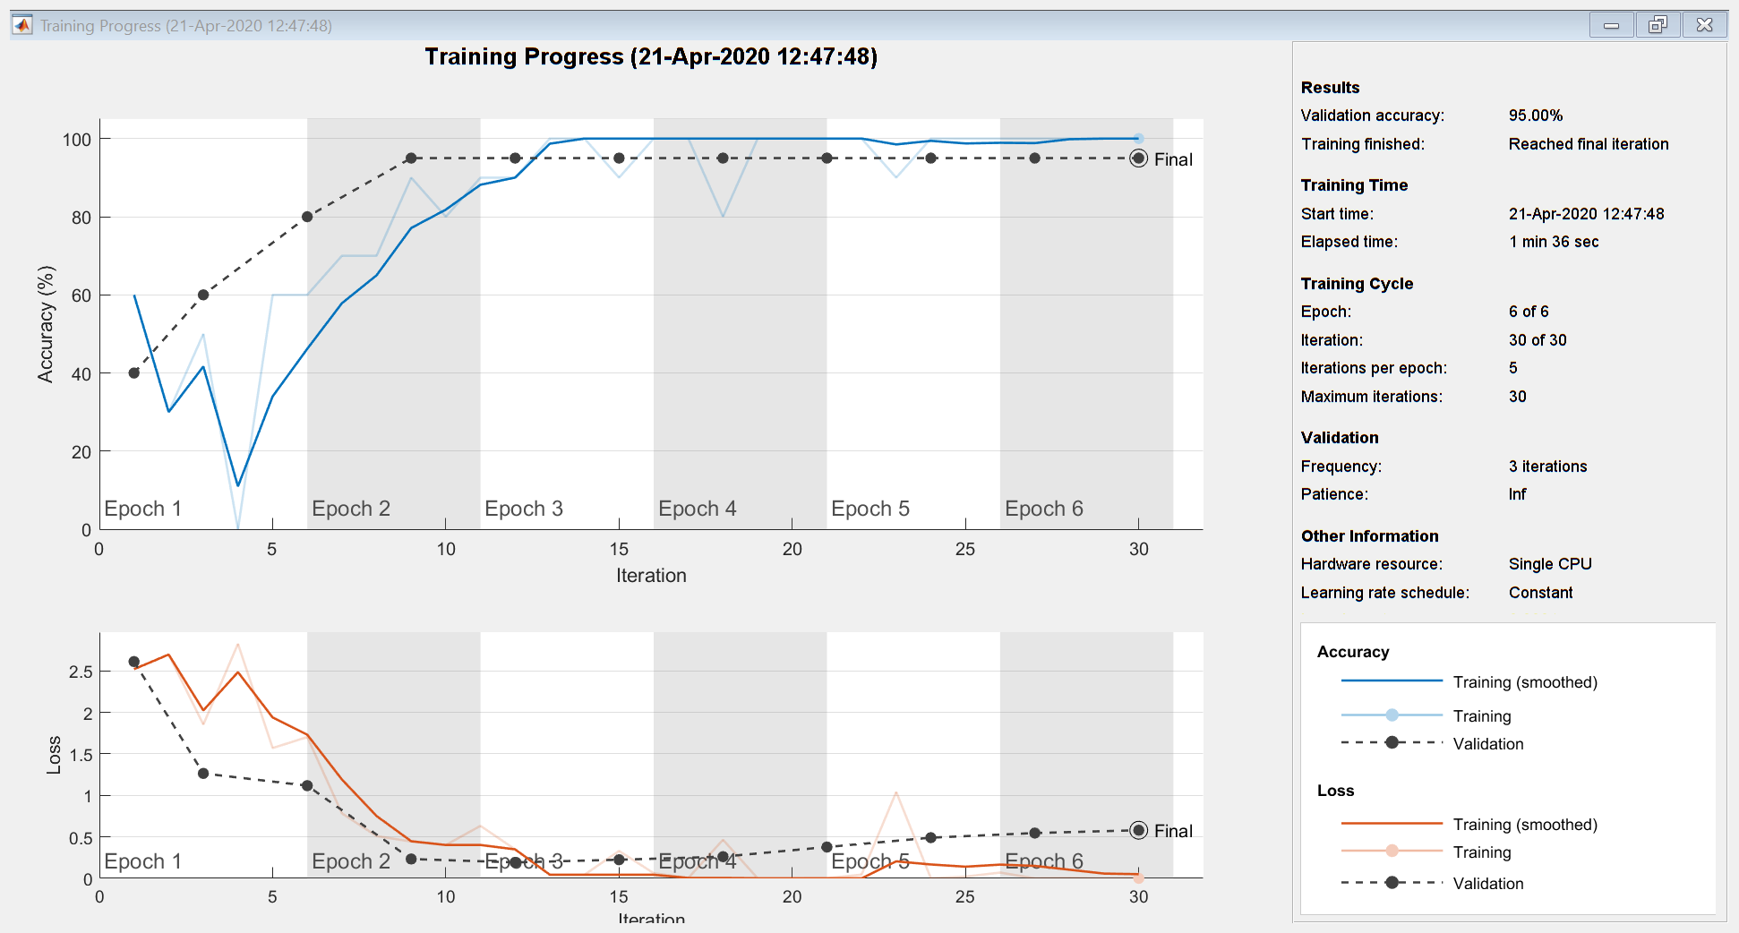
Transfer Learning Using AlexNet: Example…

Slide 60
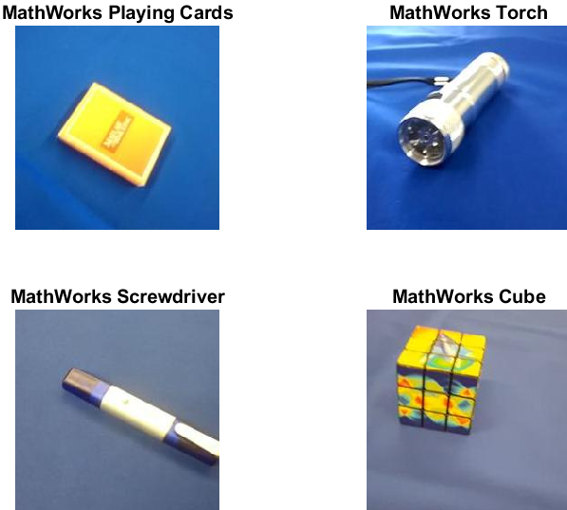
Transfer Learning Using AlexNet: Example…
Classify the validation images using the fine-tuned network.
[YPred, scores] = classify(netTransfer,augimdsValidation);
% Display four sample validation images with their predicted labels.
idx = randperm(numel(imdsValidation.Files),4);
figure
for i = 1:4
subplot(2,2,i)
I = readimage(imdsValidation,idx(i));
imshow(I)
label = YPred(idx(i));
title(string(label));
end

Slide 61
Transfer Learning Using AlexNet: Example
Calculate the classification accuracy on the validation set. Accuracy is the fraction of labels that the network predicts correctly.
This trained network has high accuracy. If the accuracy is not high enough using transfer learning, then try feature extraction instead.
YValidation = imdsValidation.Labels;
accuracy = mean(YPred == YValidation)
accuracy = 0.9500

Slide 62
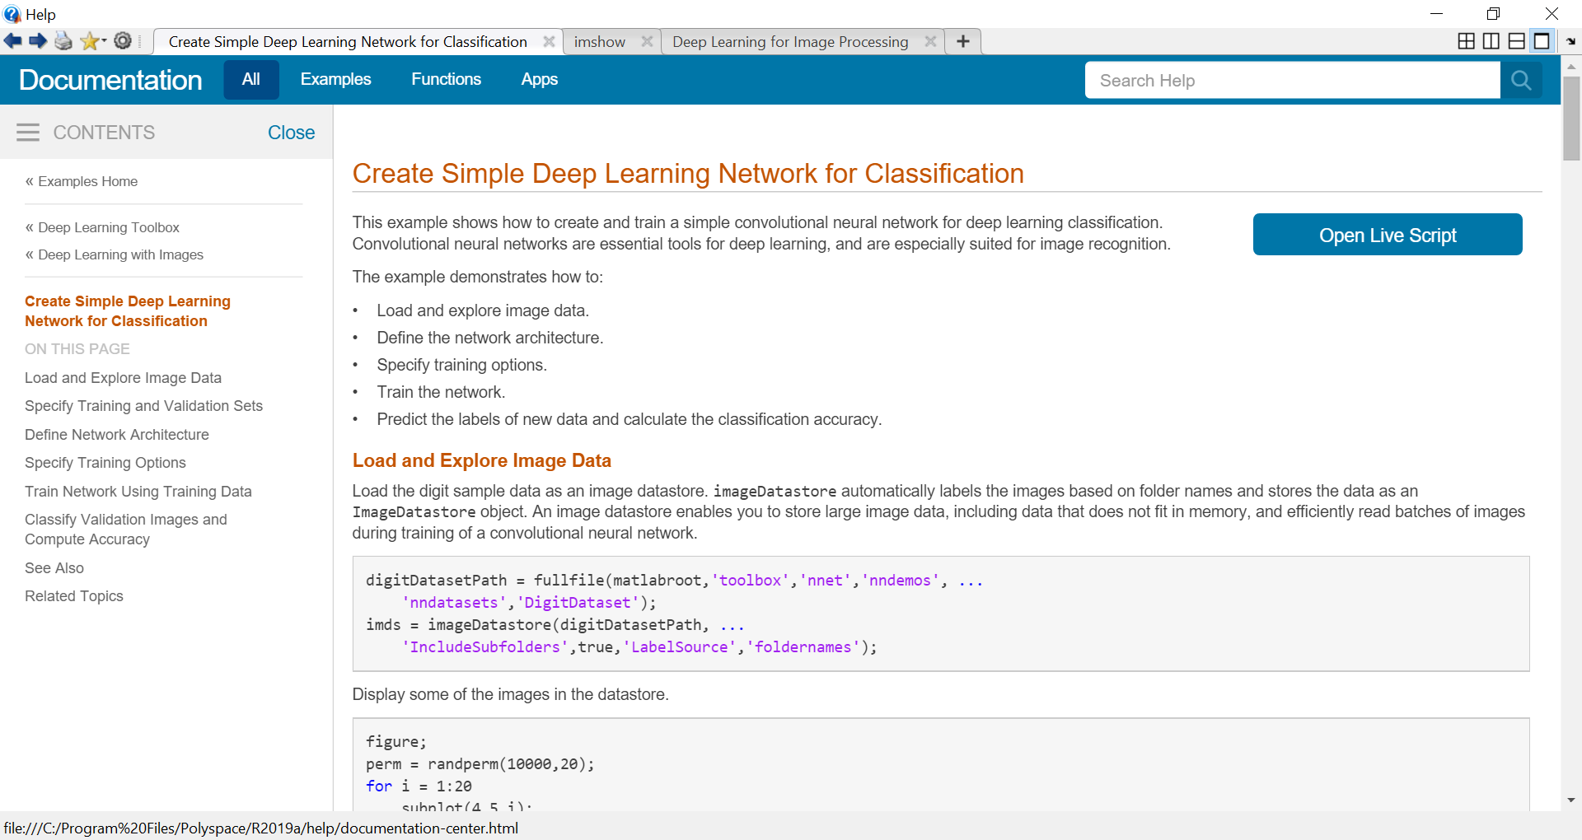
CNN Based Deep Learning Example
Notes:
TrainABasicConvolutionalNeuralNetworkForClassificationExample.mlx or
Deep_Learning_HandWritten_Digits_Classification.mlx

Slide 63
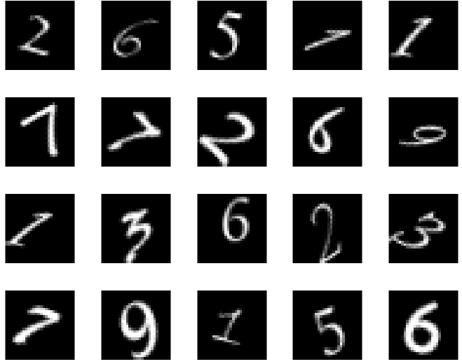
Deep Learning: Example…
% Hand written digits recognition using deep learning
clc; clear; close all;
% Load and Explore Image Data
digitDatasetPath = fullfile(matlabroot,'toolbox','nnet','nndemos', ...
'nndatasets','DigitDataset');
imds = imageDatastore(digitDatasetPath, ...
'IncludeSubfolders',true,'LabelSource','foldernames');
dataSize = size(imds.Files)
% Display some of the images in the datastore.
figure;
perm = randperm(dataSize(1), 20);
for i = 1:20
subplot(4,5,i);
imshow(imds.Files{perm(i)});
end
dataSize = 1×2 10000 1

Slide 64
Deep Learning: Example…
labelCount = countEachLabel(imds)
img = readimage(imds,1);
imageSize = size(img)
%Specify Training and Validation Sets
numTrainFiles = 750;
[imdsTrain,imdsValidation] = splitEachLabel(imds,numTrainFiles,'randomize');
 | Label | Count
1 | 0 | 1000
2 | 1 | 1000
3 | 2 | 1000
4 | 3 | 1000
5 | 4 | 1000
6 | 5 | 1000
7 | 6 | 1000
8 | 7 | 1000
9 | 8 | 1000
10 | 9 | 1000
imageSize = 1×2
28 28

Slide 65
Deep Learning: Example…
% Define the convolutional neural network architecture.
layers = [
imageInputLayer([imageSize(1) imageSize(2) 1])
convolution2dLayer(3,8,'Padding','same')
batchNormalizationLayer
reluLayer
maxPooling2dLayer(2,'Stride',2)
convolution2dLayer(3,16,'Padding','same')
batchNormalizationLayer
reluLayer
maxPooling2dLayer(2,'Stride',2)
convolution2dLayer(3,32,'Padding','same')
batchNormalizationLayer
reluLayer
fullyConnectedLayer(10)
softmaxLayer
classificationLayer
];

Slide 66
Deep Learning: Example…
Image Input Layer An imageInputLayer is where you specify the image size, which, in this case, is 28-by-28-by-1. These numbers correspond to the height, width, and the channel size. The digit data consists of grayscale images, so the channel size (color channel) is 1. For a color image, the channel size is 3, corresponding to the RGB values. You do not need to shuffle the data because trainNetwork, by default, shuffles the data at the beginning of training. trainNetwork can also automatically shuffle the data at the beginning of every epoch during training.
Convolutional Layer In the convolutional layer, the first argument is filterSize, which is the height and width of the filters the training function uses while scanning along the images. In this example, the number 3 indicates that the filter size is 3-by-3. You can specify different sizes for the height and width of the filter. The second argument is the number of filters, numFilters, which is the number of neurons that connect to the same region of the input. This parameter determines the number of feature maps. Use the 'Padding' name-value pair to add padding to the input feature map. For a convolutional layer with a default stride of 1, 'same' padding ensures that the spatial output size is the same as the input size. You can also define the stride and learning rates for this layer using name-value pair arguments of convolution2dLayer.

Slide 67
Deep Learning: Example…
Batch Normalization Layer Batch normalization layers normalize the activations and gradients propagating through a network, making network training an easier optimization problem. Use batch normalization layers between convolutional layers and nonlinearities, such as ReLU layers, to speed up network training and reduce the sensitivity to network initialization. Use batchNormalizationLayer to create a batch normalization layer.
ReLU Layer The batch normalization layer is followed by a nonlinear activation function. The most common activation function is the rectified linear unit (ReLU). Use reluLayer to create a ReLU layer.
Max Pooling Layer Convolutional layers (with activation functions) are sometimes followed by a down-sampling operation that reduces the spatial size of the feature map and removes redundant spatial information. Down-sampling makes it possible to increase the number of filters in deeper convolutional layers without increasing the required amount of computation per layer. One way of down-sampling is using a max pooling, which you create using maxPooling2dLayer. The max pooling layer returns the maximum values of rectangular regions of inputs, specified by the first argument, poolSize. In this example, the size of the rectangular region is [2,2]. The 'Stride' name-value pair argument specifies the step size that the training function takes as it scans along the input.

Slide 68
Deep Learning: Example…
Fully Connected Layer The convolutional and down-sampling layers are followed by one or more fully connected layers. As its name suggests, a fully connected layer is a layer in which the neurons connect to all the neurons in the preceding layer. This layer combines all the features learned by the previous layers across the image to identify the larger patterns. The last fully connected layer combines the features to classify the images. Therefore, the OutputSize parameter in the last fully connected layer is equal to the number of classes in the target data. In this example, the output size is 10, corresponding to the 10 classes. Use fullyConnectedLayer to create a fully connected layer.
Softmax Layer The softmax activation function normalizes the output of the fully connected layer. The output of the softmax layer consists of positive numbers that sum to one, which can then be used as classification probabilities by the classification layer. Create a softmax layer using the softmaxLayer function after the last fully connected layer.
Classification Layer The final layer is the classification layer. This layer uses the probabilities returned by the softmax activation function for each input to assign the input to one of the mutually exclusive classes and compute the loss. To create a classification layer, use classificationLayer.

Slide 69
Deep Learning: Example…
% Specify Training Options.
options = trainingOptions('sgdm', ...
'InitialLearnRate',0.01, ...
'MaxEpochs',4, ...
'Shuffle','every-epoch', ...
'ValidationData',imdsValidation, ...
'ValidationFrequency',30, ...
'Verbose',false, ...
'Plots','training-progress');
net = trainNetwork(imdsTrain,layers,options);
After defining the network structure, specify the training options. Train the network using stochastic gradient descent with momentum (SGDM) with an initial learning rate of 0.01. Set the maximum number of epochs to 4. An epoch is a full training cycle on the entire training data set. Monitor the network accuracy during training by specifying validation data and validation frequency. Shuffle the data every epoch. The software trains the network on the training data and calculates the accuracy on the validation data at regular intervals during training. The validation data is not used to update the network weights. Turn on the training progress plot, and turn off the command window output.

Slide 70
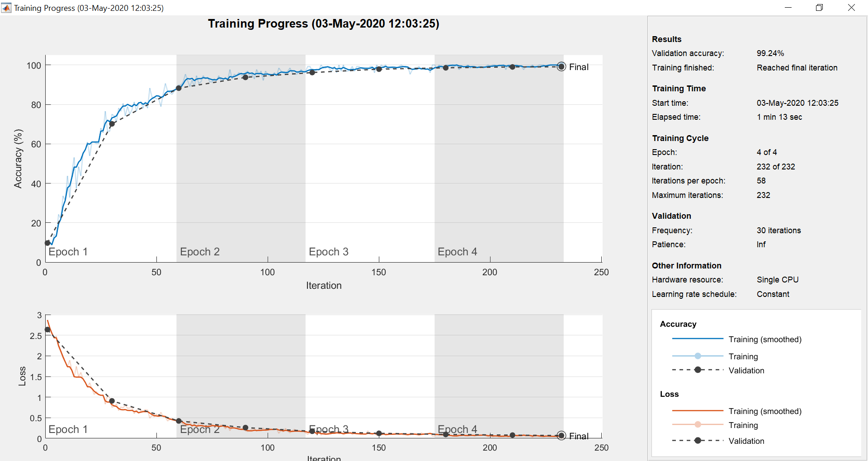
Deep Learning: Example…

Slide 71
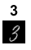
Deep Learning: Example
% Classify Validation Images and Compute Accuracy.
YPred = classify(net,imdsValidation);
YValidation = imdsValidation.Labels;
accuracy = sum(YPred == YValidation)/numel(YValidation)
% Individual testing
figure
idx = 1000;
imshow(imdsValidation.Files{idx})
label = YPred(idx);
title(string(label));
accuracy = 0.9944

Slide 72
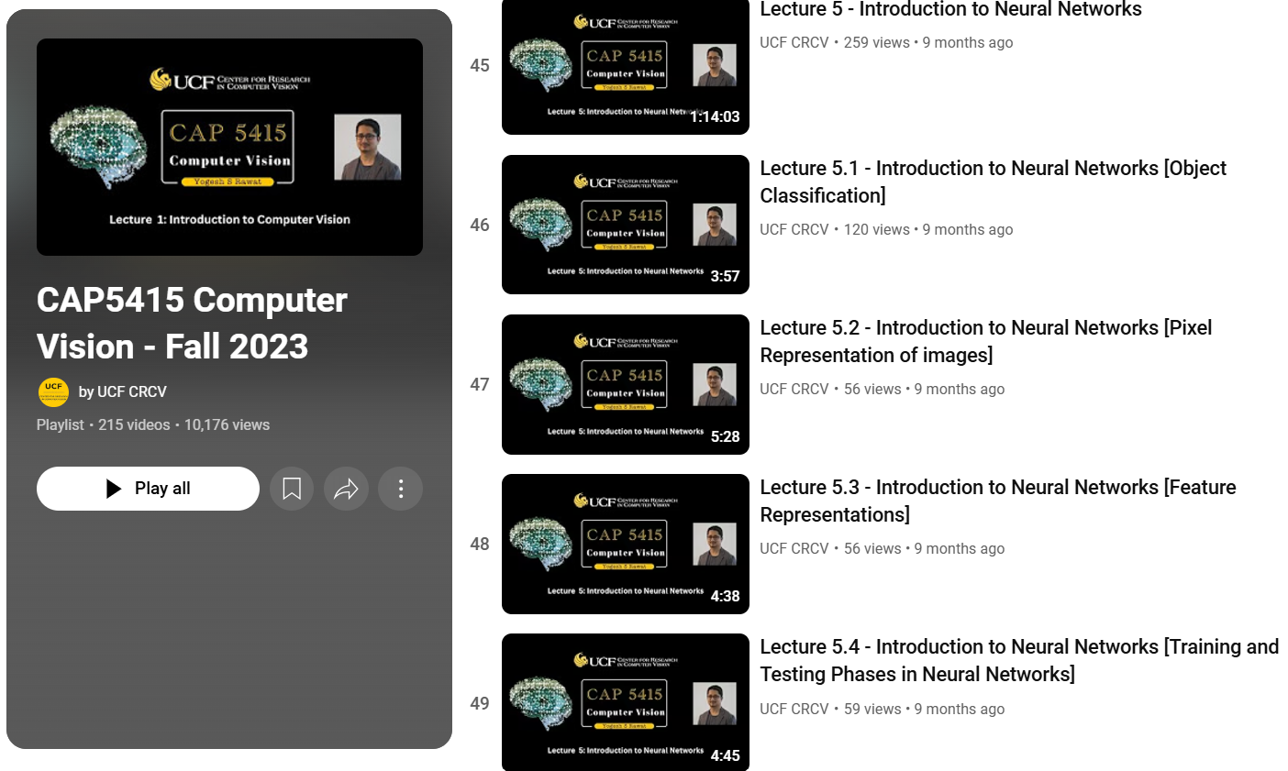
Watch: Lectures 5-7

Slide 73
Exercise
Find or prepare a dataset of any size with two types of images. Classify these two types by using the machine learning techniques in the following table on the same dataset and show their comparison in terms of accuracy and efficiency.
# | Machine Learning Algorithm | Accuracy (%age) | Efficiency (Sec) | Comments
1 | KNN
2 | SVM
3 | Deep Learning
4 | Transfer Learning

Slide 74
References
https://www.youtube.com/@UCFCRCV/videos
http://vision.stanford.edu/
https://nptel.ac.in/courses/106/105/106105216/
http://cs.stanford.edu/people/karpathy/
http://www.vision.ee.ethz.ch/~daid/EnProDeepFets/
http://natureofcode.com/book/chapter-10-neural-networks/
http://dipwm.blogspot.com/2013/01/svm-support-vector-machine-with-matlab.html

Slide 75
Extra Stuff

Slide 76
Classification Algorithms
Classification Model Training
Each model is trained to detect a specific type of object. The classification models are trained by extracting features from a set of known images. These extracted features are then fed into a learning algorithm to train the classification model. Computer Vision System Toolbox software uses the Viola-Jones cascade object detector. This detector includes Haar-like [6] features and cascade of classifiers trained using boosting.
The image size used to train the classifiers defines the smallest region containing the object. Training image sizes vary according to the application, type of target object, and available positive images. You must set the MinSize property to a value greater than or equal to the image size used to train the model…..
Notes:
MATLAB R2012a: vision.CascadeObjectDetector

Slide 77
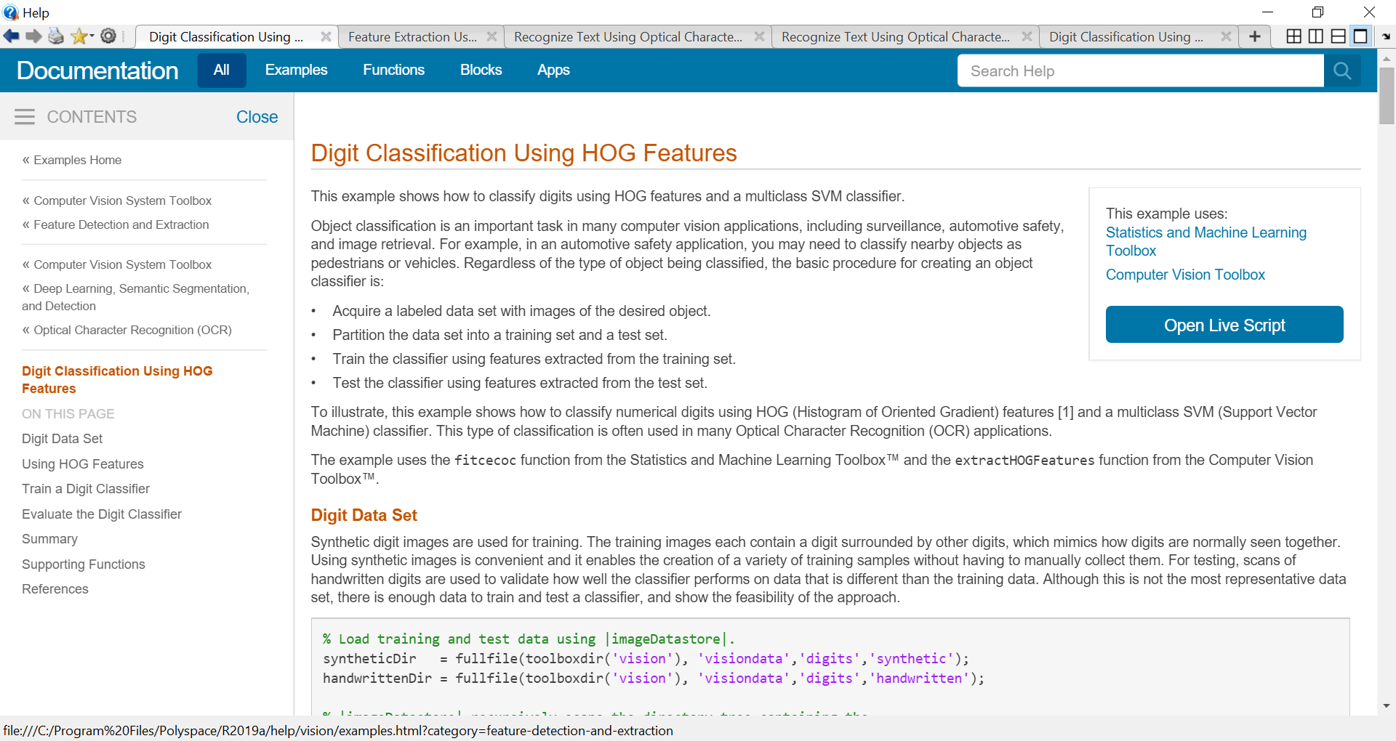
Classification Algorithms

Slide 78
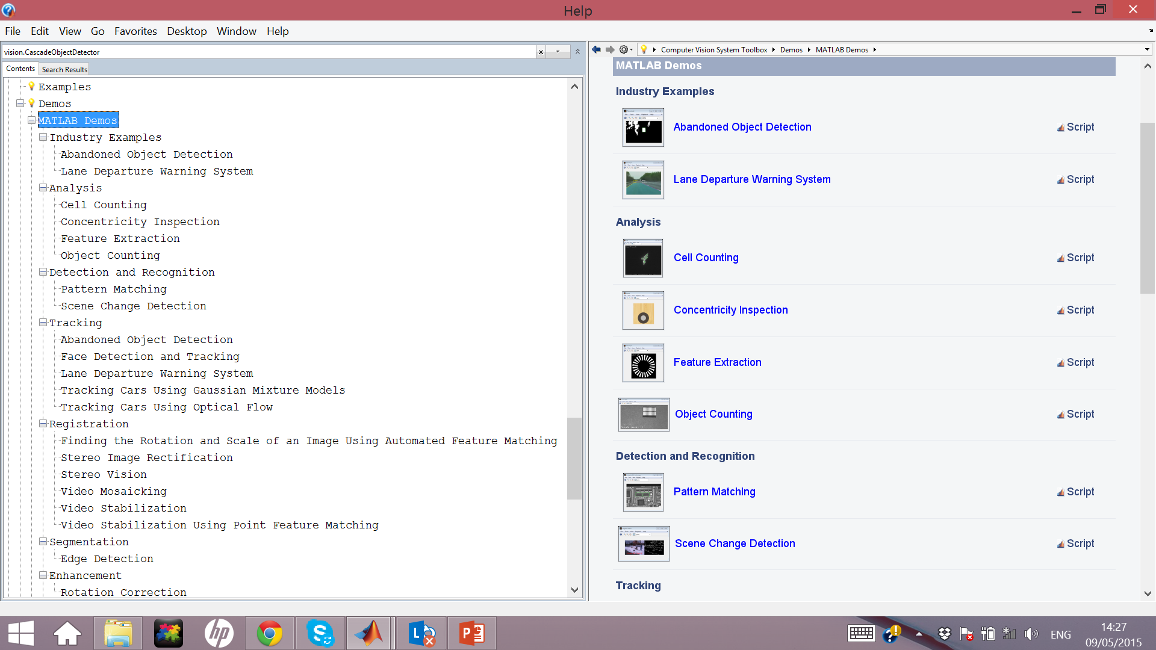
MATLAB DEMOS
Notes:
MATLAB R2012a

Slide 79
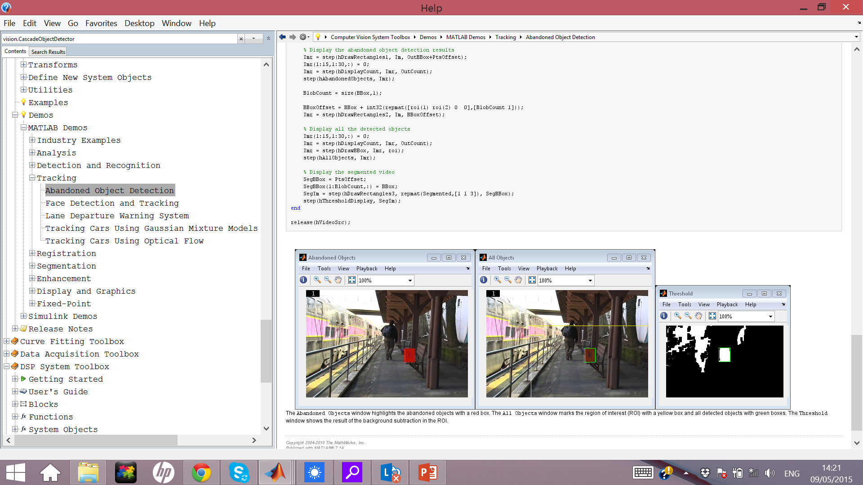
Auto Video Surveyalance
Abandoned Object Detection
Notes:
MATLAB R2012a

Slide 80
A Simple Classifier: Nearest Neighbor
1. Collect a dataset of images and label them
2. Use Machine Learning to train an image classifier
3. Evaluate the classifier on a withheld set of test images
Example training set

Slide 81
A Simple Classifier: Nearest Neighbor
Example dataset: CIFAR-10
10 labels
50,000 training images
10,000 test images.
For every test image (first column),
examples of nearest neighbors in rows

Slide 82
A Simple Classifier: Nearest Neighbor
How do we compare the images?
What is the distance metric?

